Slide 1


ITM 540
Data Networks
The Physical Layer - Digital Transmission
Carol Davids
Carol Davids © 2014

Slide 2
Reading Assignment
Forouzan: Chapter 4 - Digital Transmission:
  Section 4.1 – Digital to digital conversion
  Section 4.3 – Transmission modes
Carol Davids © 2014

Slide 3
Line Code
A line code provides a translation from groups of logical bits to groups of physical signals.
Distinguish between logical ‘bits’ and physical signals
Carol Davids © 2014

Slide 4
Bit rate vs. Signal rate
The rate at which bits appear to be sent is called the bit rate
The rate at which signals are created is called the signal rate
The signal rate is also sometimes called the baud rate.
Carol Davids © 2014

Slide 5
Data Elements vs. Signal Elements
Think of using a code book to translate strings of bits into strings of physical signals
You use the code book to translate data elements (bits) into signal elements (bauds).
Data element | Signal element
bbbb | S
bbbb | S
Line code book
Carol Davids © 2014

Slide 6
Data Elements vs. Signal Elements
We will speak of the number of bits per signal or bits per baud.
The text book uses the letter ‘r’ to represent this ratio of bits/signal.
Data element | Signal element
bbbb | S
bbbb | S
Line code book
Carol Davids © 2014

Slide 7
Data Elements vs. Signal Elements
Signal rate: S = signals/second
Data rate: N = bits/second
Relationship between S and N
N is proportional to S
That is, if you want to send more bits per second, you have to send more signals per second
Carol Davids © 2014

Slide 8
Data Elements vs. Signal Elements
S and N are related by the ratio r
r = bits/signal
S = N / r or r x S = N
Check the units
signals/sec = (bits/sec) / (bits/signal)
= (bits/sec) (signals/bit)
= (signals/sec)
Carol Davids © 2014

Slide 9
Example 1: One bit -> One of two distinct signal levels
The code book shown below translates the bit ‘0’ to a pulse of height 0 volts.
It translates the bit ‘1’ to a pulse with a positive polarity.
Unipolar Line Code
Bit | Signal Polarity
0 | 0
1 | +
Carol Davids © 2014

Slide 10
Example 1: One bit -> One of two distinct signal levels
Polarity refers to whether the signal has a positive voltage or a negative voltage.
The value of polarity can be ‘plus’ (+) or ‘minus (-)
Unipolar Line Code
Bit | Signal Polarity
0 | 0
1 | +
Carol Davids © 2014

Slide 11
Example 1: One bit -> One of two distinct signal levels
In this example, r = 1, or there is 1 bit per baud
Unipolar Line Code
Bit | Signal Polarity
0 | 0
1 | +
Carol Davids © 2014

Slide 12
Example 2: One bit -> One of two distinct signal levels
The code book shown below translates the bit ‘0’ to a pulse with a positive polarity and height A.
It translates the bit ‘1’ to a pulse with negative polarity and height A.
Polar : NRZ-L
Bit | Signal Polarity
0 | +
1 | -
Carol Davids © 2014

Slide 13
Example 2: One bit -> One of two distinct signal levels
In this example, r = 1, and there is 1 bit per baud
Polar : NRZ-L
Bit | Signal Polarity
0 | +
1 | -
Carol Davids © 2014

Slide 14
Example 3: One bit -> One of 2 distinct signal levels
In this example, r=1 and there is 1 bit per baud
Polar : NRZ-L
Bit | Signal Polarity
0 | +
1 | -
Carol Davids © 2014

Slide 15
Example 4: Two bits -> One of four distinct signal levels
4QAM code book
The code book shown at right translates the bits ‘00’ to a signal element whose phase is 0.
It translates the bits ‘01’ to a signal element whose phase is 90.
And so forth.
Bit Pattern | Signal level
00 | Phase = 0°
01 | Phase = 90°
10 | Phase = 180°
11 | Phase = 270°
Carol Davids © 2014

Slide 16
Example 4: Two bits -> One of four distinct signal levels
4QAM code book
In this example, r=2 and there are 2 bits per baud
Bit Pattern | Signal level
00 | Phase = 0°
01 | Phase = 90°
10 | Phase = 180°
11 | Phase = 270°
Carol Davids © 2014

Slide 17
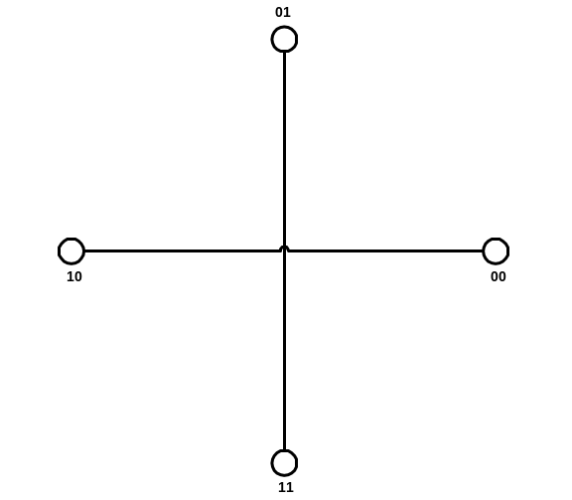
4QAM Illustration
Use 4 symbol values to represent the 4 different ways you can combine 2 bits.
4 QAM : 4 valued Quadrature
Amplitude Modulation: Both phase and amplitude of signal can be changed: In this example, the amplitude of the wave is constant; phase of the wave can have one of 4 different values; illustrated here, those values are 0°, 90°, 180°, and 270°.
Carol Davids © 2014

Slide 18
Example 5: Three bits -> One of 8 distinct signal levels
Bit Pattern | Signal level
000 | Amplitude 1, Phase = 0°
001 | Amplitude 1, Phase = 90°
010 | Amplitude 1, Phase = 180°
011 | Amplitude 1, Phase = 270°
100 | Amplitude 2, Phase = 0°
101 | Amplitude 2, Phase = 90°
110 | Amplitude 2, Phase = 180°
111 | Amplitude 2, Phase = 270°
8QAM code book
The code book at right translates the bits ‘000’ to a signal with amplitude 1 and phase 0.
It translates the bits ‘101’ to a signal with amplitude 2 and phase 90.
And so forth..
Carol Davids © 2014

Slide 19
Example 5: Three bits -> One of 8 distinct signal levels
Bit Pattern | Signal level
000 | Amplitude 1, Phase = 0°
001 | Amplitude 1, Phase = 90°
010 | Amplitude 1, Phase = 180°
011 | Amplitude 1, Phase = 270°
100 | Amplitude 2, Phase = 0°
101 | Amplitude 2, Phase = 90°
110 | Amplitude 2, Phase = 180°
111 | Amplitude 2, Phase = 270°
8QAM code book
In this example, r = 3 and there are 3 bits per baud
Carol Davids © 2014

Slide 20
Example 6: Two bits -> 1 of 4 distinct signal levels
Bit Pattern | Last Signal Polarity |  | Signal Value
00 | + |  | +1
00 | - |  | -1
01 | + |  | +3
01 | - |  | -3
10 | + |  | -1
10 | - |  | +1
11 | + |  | -3
11 | - |  | +3
The code book at right translates the bits ‘00’ to a signal with amplitude +1 IF the last signal polarity you put onto the medium was positive.
It translates the bits ‘00’ to a signal with amplitude -1 IF the last signal polarity you put onto the medium was negative.
2B1Q Code Book
Carol Davids © 2014

Slide 21
Example 6: Two bits -> 1 of 4 distinct signal levels
Bit Pattern | Last Signal Polarity |  | Signal Value
00 | + |  | +1
00 | - |  | -1
01 | + |  | +3
01 | - |  | -3
10 | + |  | -1
10 | - |  | +1
11 | + |  | -3
11 | - |  | +3
This line code is called 2 binary 1 quaternary
This refers to the fact that we are using 4 signal values {+1, -1, +3, -3} and each of these signal levels represents a unique pattern of 2 bits
2B1Q Code Book
Carol Davids © 2014

Slide 22
Example 6: Two bits -> 1 of 4 distinct signal levels
Bit Pattern | Last Signal Polarity |  | Signal Value
00 | + |  | +1
00 | - |  | -1
01 | + |  | +3
01 | - |  | -3
10 | + |  | -1
10 | - |  | +1
11 | + |  | -3
11 | - |  | +3
In this example, r = 2 and there are 2 bits per baud
2B1Q Code Book
Carol Davids © 2014

Slide 23
Pulse rate vs. Bit rate
A pulse or a symbol is the actual physical state that we send and detect over the medium.
It might be the voltage state on the wire or it might be the amplitude and phase of a radio frequency wave.
The pulse rate or symbol rate represents the number of pulses or symbols per second.
Carol Davids © 2014

Slide 24
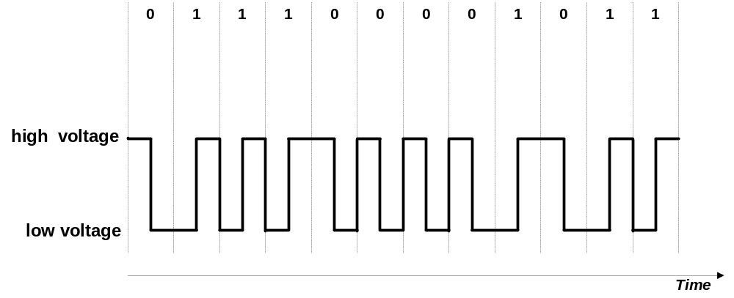
Pulse rate vs. Bit rate
If we use 2 pulses or symbols to represent one bit, then the pulse rate or symbol rate will be twice as great as the bit rate. r=1/2
Carol Davids © 2014

Slide 25
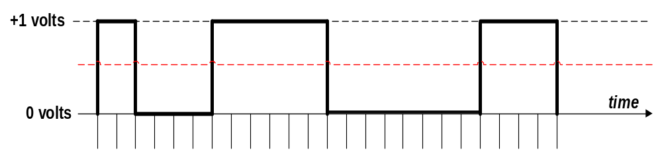
Illustration 1: Pulse rate vs. Bit rate
Here we use 1 pulse (symbol) to represent one bit.
The illustration shows 24 time intervals.
If there is one symbol every .02 milliseconds then the symbol rate is 50 Kbaud per second and also 50 Kbits per second.
Carol Davids © 2014

Slide 26
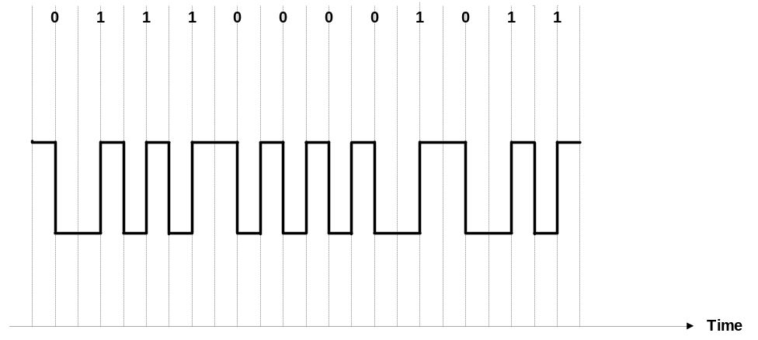
Illustration 2: Pulse rate vs. Bit rate
Here we use 2 pulses or symbols to represent one bit.
The illustration shows 24 time intervals.
Carol Davids © 2014

Slide 27

Illustration 2: Pulse rate vs. Bit rate
There is still one symbol every .02 milliseconds so the symbol rate is still 50 Kbaud per second
But the logical data rate or bit rate is one bit every .04 milliseconds, so the data rate is 25 Kbits per second.
Carol Davids © 2014

Slide 28
Characteristics of the signals we create
Analog Bandwidth
Baseline Wandering
DC Components
Self-synchronization
Built-in Error detection
Immunity to noise and interference
Complexity
Carol Davids © 2014

Slide 29
1. Analog bandwidth of the signal
The characteristics of the transmission medium – in particular - how fast it can change signal state – will limit the baud rate.
The limit on the baud rate will limit the bit rate.
Thus if we are sending 2 bits per baud, an upper limit of 100 baud per second will result in an upper limit of 200 bits per second.
Carol Davids © 2014

Slide 30
Bit rate, Baud rate and Data Rate
Let B be the analog bandwidth – since we are interested in base band transmission now, this is the highest frequency in the signal we are putting onto the transmission medium
Cycles/second
Carol Davids © 2014

Slide 31
Bit rate, Baud rate and Data Rate
Let N be the bit rate at which our data appears to be carried over the transmission medium
Bits/second
Carol Davids © 2014

Slide 32
Bit rate, Baud rate and Data Rate
Let S be the rate at which signals are sent over the transmission medium
Baud = signals/second
Carol Davids © 2014

Slide 33
Bit rate, Baud rate and Data Rate
We consider 3 cases and associate a multiplier, ‘c’, to quantify them.
  Worst Case: The string of bits you need to translate demands the maximum baud
  Best Case: The string of bits you need to translate demands the minimum baud
  Average Case: The string of bits you need to translate does not require max or min baud
Carol Davids © 2014

Slide 34
Bit rate, Baud rate and Data Rate
Now we ask the question: How much analog bandwidth do we need to carry a particular bit rate?
B_{min} = c x N X 1/r
Check the units
  Cycles/sec = bits/sec * symbols/bit
  Cycles/sec = symbols/sec
Carol Davids © 2014

Slide 35
Bit rate, Baud rate and Data Rate
If you know the bandwidth of your channel, you can determine the maximum bit rate achievable in that channel by manipulating that equation as follows:
N_{max} = 1/c * B * r
Check units:
  Bits/sec = cycles/sec * bits/symbol
  Bits/sec = bits/sec
Carol Davids © 2014

Slide 36
Remember Nyquist’s Formula
Nyguist demonstrated that
N_{max} = 2*B*log₂L
If we let c = ½, for the average case, then the relationship we just derived reduces to the Nyquist Formula
This is because r = the number of bits per symbol, and the number of bits per symbol is log₂L
Carol Davids © 2014

Slide 37
2. Baseline wandering
The receiver of the signal calculates the power in the received signal
It keeps a running average of this power
It compares the average or baseline power to the power in the currently incoming signal
This comparison is used to determine the value of the data element (is it a +3, or a +1, or a -3, or a -1 for example.)
Carol Davids © 2014

Slide 38
Baseline wandering
A particular pattern in the data bits can cause the running average or baseline to be skewed
That will make future comparisons problematic
An example of such a problem would be if you encoded the bit 0 as the level 0 volts.
Then, a long string of 0’s in the data stream would result in a long period of time during which the power in the signal was 0 watts
Carol Davids © 2014

Slide 39
3. DC Components
A particular pattern in the data bits can also cause the signal that we put onto the medium to have a constant non-zero voltage for a long period of time.
The flat line signal thus created has a high amplitude spike at the 0 Hz location in the frequency domain.
Carol Davids © 2014

Slide 40
DC Components
That is, the signal has a large component of direct current. This can cause two types of problem.
First, some network elements, such as capacitors and some telecommunications links, cannot pass direct currents at all.
This means that the received signal cannot be decoded to represent the bits you intended to send.
Carol Davids © 2014

Slide 41
DC Components
Second, the DC component on the line will have polarity – it will be either positive or negative.
This positive or negative ‘bias’ can interfere with signals in neighboring lines and can also cause the received signal to be mis-interpreted.
Carol Davids © 2014

Slide 42
4. Self-Synchronization
Self-Synchronization refers to the ability of the receiver to learn when the clock ‘ticked’ at the sending side.
The goal is to have the receiver’s clock ticking in phase with the sender’s.
If the receiver can figure out when the sender’s clock ‘ticked’ from the signal itself, this is a valuable attribute.
Carol Davids © 2014

Slide 43
Synchronization
The receiver’s symbol intervals need to correspond to the sender’s symbol intervals.
If the sender’s and receiver’s clocks are running at different rates, the receiver may interpret the same physical square wave to represent a different pattern of 0’s and 1’s than the sender intended.
Carol Davids © 2014

Slide 44
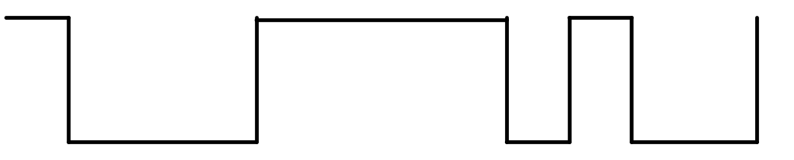
Synchronization
The image below represents the signal values that are put onto the transmission medium.
Carol Davids © 2014

Slide 45
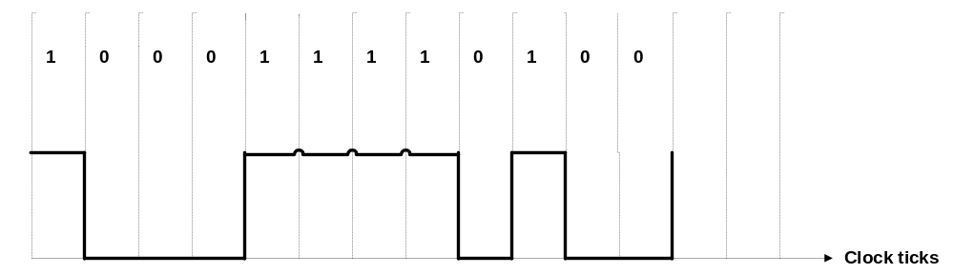
Synchronization
On the first clock tick, a logic 1 - represented by a high signal value - was sent.
On each of the next three clock ticks, a logic 0 - represented by a low signal value - was sent.
Carol Davids © 2014

Slide 46
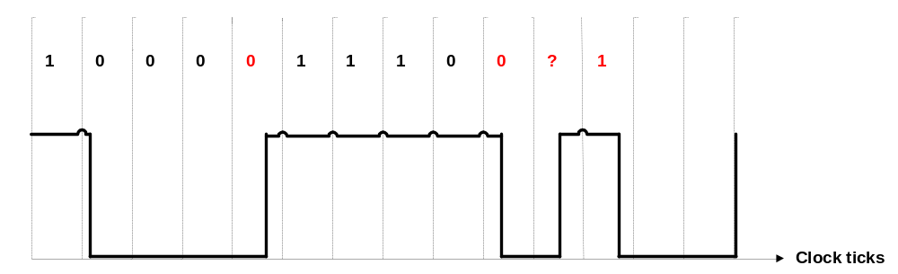
Synchronization
The same voltage pattern that was sent is received.
But if the clock in the receiving device is running at a different rate than the clock on the sending device it may interpret the voltage pattern differently.
1
Carol Davids © 2014

Slide 47

Synchronization
Illustration 4.3 from text book: The clock at the receiver is ticking faster than the one at the sender. The receiver senses the incoming signal twice during the + voltage pulse, whereas the sender only intended for it to be sensed once.
Carol Davids © 2014

Slide 48
Self Synchronization
A self-synchronizing digital signal includes timing information in the data being transmitted.
‘Knife edges’ – vertical lines in the received signal - can be used to alert the receiver to the beginning middle or end of the pulse.
The goal is to put as many of these verticals or transitions into the signal
The receiving device can synchronize its clock using the rising or the falling edge of a pulse.
Carol Davids © 2014

Slide 49
Line Coding Schemes
Line codes can be divided into the following categories:
  Unipolar
  Polar
  Bipolar
  Multilevel
  Multitransition
Carol Davids © 2014

Slide 50

Line Coding Schemes
Figure 4.4 shows the different categories of line codings.
Carol Davids © 2014

Slide 51
Polarity
Three types of polarity that can be used for line codes:
  Unipolar
  Polar
  Bipolar
Carol Davids © 2014

Slide 52
Polarity – preview…
Unipolar – refers to the fact that there is only one polarity in use
Polar – refers to the fact that there are two polarities in use
Bipolar – refers to the fact that there are two polarities in use AND the bit ‘1’ or ‘0’ can be assigned either of the polarities depending on other factors!
Carol Davids © 2014

Slide 53
Unipolar Line Code
One bit is represented by a non-zero voltage.
The other bit is represented by zero voltage.
There is thus only one polarity
For example, ‘1’ might be represented by zero volts, and ‘0’ might be represented by +1.5 volts.
Carol Davids © 2014

Slide 54
Non Return to Zero (NRZ)
Non Return to Zero refers to the fact that during the period of time when we are signaling a single bit, the signal we are using does not go to the zero value.
Carol Davids © 2014

Slide 55
DC component of unipolar signals
Since the average of the non-zero and zero values will be a non-zero value there is a DC component associated with a unipolar line code.
This buildup of a DC bias causes errors on the line and unipolar codes are not used any more for this reason.
Carol Davids © 2014

Slide 56
Illustration 1: DC Component of unipolar signal
There are 24 bit intervals shown.
In 12 of them the signal value is 1 volt.
In 12 of them the signal value is 0 volt.
The average of the signal values is .5 volts.
This is the DC component or bias on the line.
Carol Davids © 2014

Slide 57
Synchronization of unipolar signals
Unipolar line codes do not support self- synchronization.
Long strings of zero’s prevent a receiver from using a rising or falling edge to synchronize their clocks.
Carol Davids © 2014

Slide 58
Polar Line Code
Polar codes use two non-zero voltages, one positive and the other negative.
One of these non-zero voltages represents logic ‘1’.
The other of these non-zero voltages represents logic ‘0’.
Polar line codes use non-zero voltages of equal magnitude and opposite polarity to represent logical 0 and logical 1.
Carol Davids © 2014

Slide 59
DC Component of polar line codes
The average of the signal values in polar line codes is closer to zero, which means that there is hardly any DC bias associated with a polar line code.
Carol Davids © 2014

Slide 60
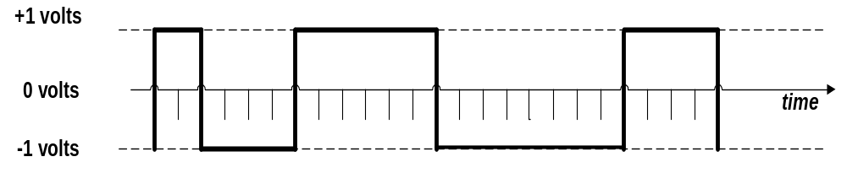
Illustration 2 : DC Component of polar code
There are 24 bit intervals shown.
In 12 of them the signal value is +1 volt.
In 12 of them the signal value is -1 volt.
The average of the signal values is 0 volts.
This is the DC component or bias on the line.
Carol Davids © 2014

Slide 61
Four different Polar Line Codes
There are 4 important polar line codes:
  NRZ - Non-Return to Zero
  RZ - Return to Zero
  Manchester
  Differential Manchester
Carol Davids © 2014

Slide 62

NRZ: Non Return to Zero
The value of the signal is either positive or negative.
The value of the signal is never zero.
Carol Davids © 2014

Slide 63
NRZ-L: Non Return to Zero-Level
NRZ-L: NRZ-Level:
  Positive voltage represents a ‘0’ bit
  Negative voltage represents a ‘1’ bit.
L refers to the fact that the polarity or level of the signal is dictated by the value of the bit it is being used to represent
Carol Davids © 2014

Slide 64

NRZ-L Code Book
Polar : NRZ-L (the signal’s polarity is dictated by the bit value)
Carol Davids © 2014

Slide 65
NRZ-I: Non Return to Zero - Invert
NRZ-I: NRZ-Invert:
  Transition in signal polarity at beginning of bit interval represents ‘1’ bit
  No voltage transition in signal polarity at beginning of bit interval represents ‘0’ bit.
Invert refers to the fact that the inversion or change of the polarity or level of the signal is used to represent a 1 bit.
Carol Davids © 2014

Slide 66
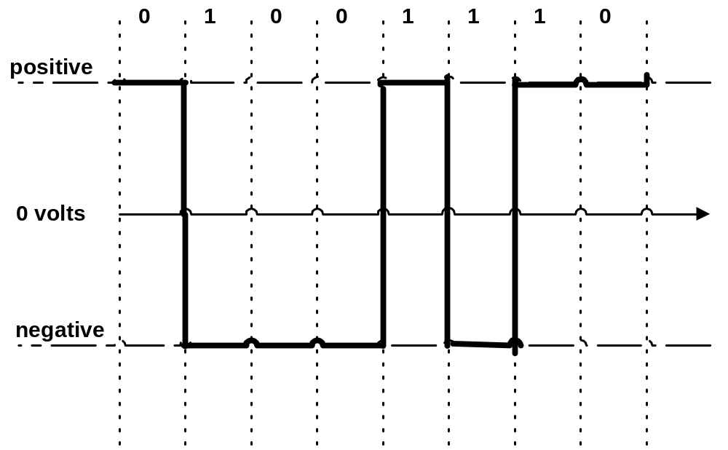
NRZ-I and synchronization
Carol Davids © 2014

Slide 67
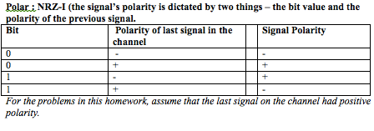
NRZ-I Code Book
Two pieces of information are needed to determine what signal to put on the line.
Carol Davids © 2014

Slide 68
NRZ-L and synchronization
NRZ-L does not provide self-synchronization.
The receiver could receive a long stream of 0’s or a long stream of 1’s and loose track of which bit it is decoding.
Carol Davids © 2014

Slide 69
NRZ-I and synchronization
NRZ-I does provide some self-synchronization.
Every time a 1 is encountered in the data stream, the polarity of the signal changes.
The change provides an ‘edge’ on which the receiver can synchronize.
A long string of zeros can still create a problem with synchronization.
Carol Davids © 2014

Slide 70
NRZ-L vs. NRZ-I
Carol Davids © 2014

Slide 71

Polar RZ (Return to Zero) Signals
The signal returns to the zero level at some time in the middle of every bit interval.
Carol Davids © 2014

Slide 72
A Return to Zero Scheme
Signal level changes during each bit interval.
There is a zero voltage in every bit interval
  ‘1’ is represented by the transition from positive voltage to zero voltage in the middle of the bit interval.
  ‘0’ is represented by the transition from negative voltage to zero voltage in the middle of the bit interval.
Carol Davids © 2014

Slide 73
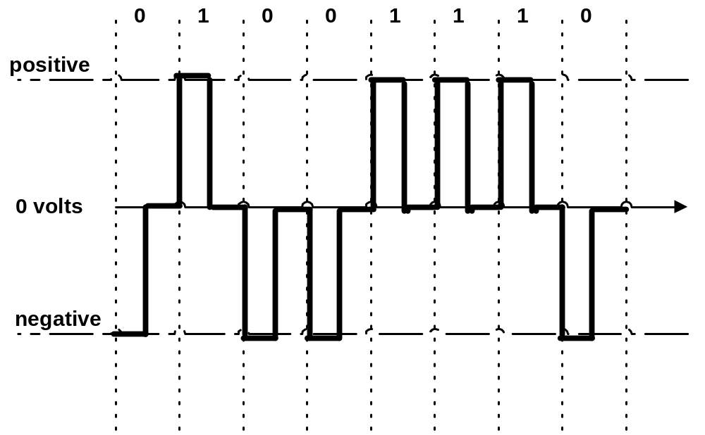
Return to Zero
1
0
Carol Davids © 2014

Slide 74
Return to Zero
RZ encoding requires two signal changes to encode one bit
But each signal change allows the receiver to synchronize
Carol Davids © 2014

Slide 75
Return to Zero – the balance sheet
Signal has high bandwidth
Sudden change in line’s polarity destroys your data – causes ‘1’ to be interpreted as ‘0’ and ‘0’ to be interpreted as ‘1’
There is no DC component
Carol Davids © 2014

Slide 76

Return to Zero – Code Book
Return to Zero (RZ) (signal is always 0 at the end of the bit interval)
Carol Davids © 2014

Slide 77
Manchester Encoding
  The line code used by Ethernet networks is called Manchester Encoding.
  The line state cannot be 0 volts.
  The line state can be a positive voltage or a negative voltage
Carol Davids © 2014

Slide 78
Manchester Encoding
In Manchester coding there is a transition between two voltage levels at the middle of each bit interval.
Negative-to-Positive transition represents ‘1’.
Positive-to-Negative transition represents ‘0’.
These transitions also provide an edge upon which the receiving clock can synchronize every time bit is sent.
Carol Davids © 2014

Slide 79
Bit rate vs. baud rate in Manchester encoding
The term bit interval was used in this definition
Remember a bit is a logical thing
The bit interval is the period it takes to send a bit
In this scenario it took two pulse intervals – that is to say – two symbols - to create a single bit
So it takes two pulse intervals to make one bit interval
So the baud rate is twice the bit rate: Or, the bit rate is half the baud rate. r = 1/2
Carol Davids © 2014

Slide 80
Manchester Encoding
‘0’
‘1’
Carol Davids © 2014

Slide 81
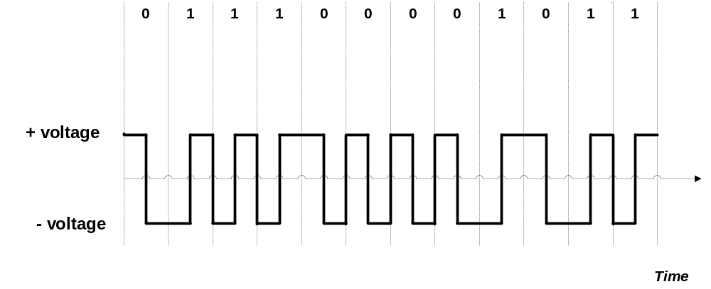
Manchester Encoding
Suppose 0.1
microseconds per bit
Low-to-High transition represents 1.
High-to-Low transition represents 0.
Carol Davids © 2014

Slide 82
Manchester Encoding Baud Rate vs. Bit Rate
Notice that the Baud rate (signal rate,pulse rate) is twice as fast as the data rate (bit rate).
Because it takes two pulses to represent one bit.
Carol Davids © 2014

Slide 83
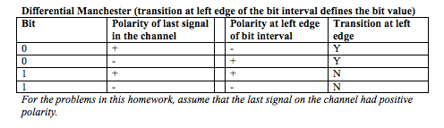
Manchester – Code Book
Carol Davids © 2014

Slide 84
Differential Manchester
Differential Manchester resembles NRZ-I in that it is the inversion of the pulse level at the beginning of a bit interval that is used to encode a bit.
To encode a 1, don’t change the signal’s polarity
To encode a 0, do change the signal’s polarity
Carol Davids © 2014

Slide 85
Differential Manchester
In the case of Differential Manchester
An inversion or change of polarity at the beginning of the bit interval encodes a 0 bit
No inversion or change of polarity at the beginning of the bit interval encodes a 1 bit
Carol Davids © 2014

Slide 86
Differential Manchester
In differential Manchester encoding, a transition between the two signal states - AT THE BEGINNING OF A BIT INTERVAL - represents bit ‘0’
No transition AT THE BEGINNING OF A BIT INTERVAL - represents bit ‘1’
There is also a transition at the middle of the bit interval
The transition at the middle of a bit interval is used for synchronization only.
Carol Davids © 2014

Slide 87
Differential Manchester
There is ALSO a transition at the middle of the bit interval
The transition at the middle of a bit interval is used for synchronization only.
Carol Davids © 2014

Slide 88
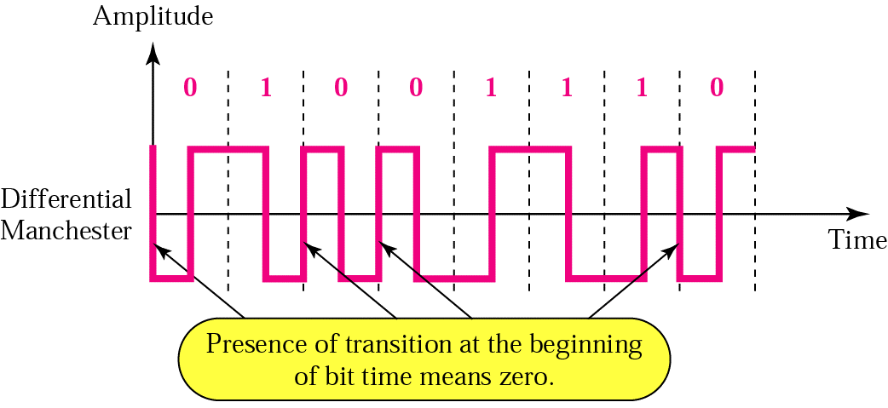
Differential Manchester
Illustration of differential Manchester encoding
Carol Davids © 2014

Slide 89
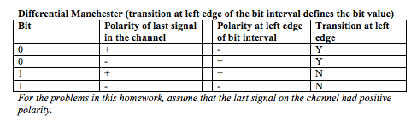
Differential Manchester- Code Book
Two pieces of information are needed to determine what signal to put onto the line.
Carol Davids © 2014

Slide 90

Manchester Encoding
Illustration 4.8 shows that the bandwidth of this polar, biphase signal is smaller than the bandwidth of the polar RZ signal.
Carol Davids © 2014

Slide 91

Bipolar Line Codes
Use the 0 signal level to represent a bit (‘1’ or ‘0’).
Use alternating positive and negative polarities to represent the other bit (‘0’ or ‘1’).
Carol Davids © 2014

Slide 92
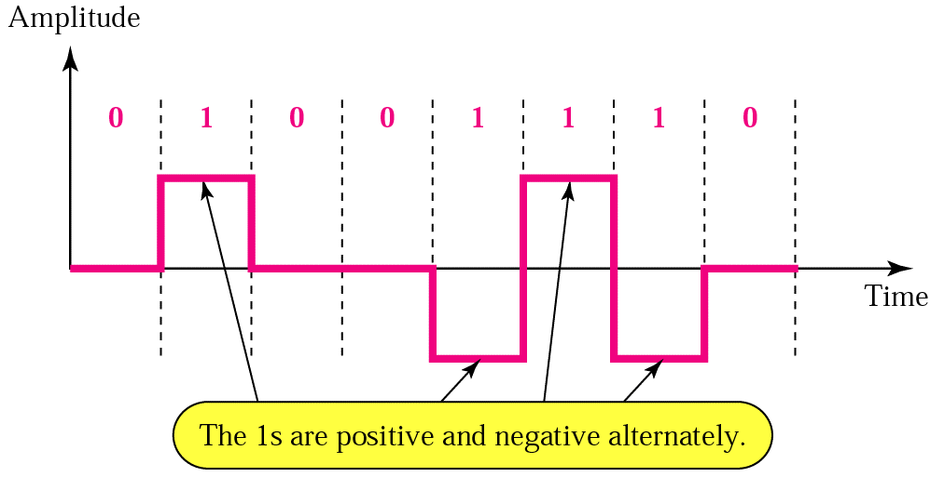
Bipolar Line Codes
‘1’ is encoded alternately as a positive voltage and as a negative voltage, depending upon the value of the signal used to encode the last ‘1’ bit that was sent.
Carol Davids © 2014

Slide 93
Bipolar Line Codes
Note the term ‘bipolar’ refers to the fact that one bit can be encoded with one of two different polarities - either positive or negative - depending on past history.
The term does not refer to the fact that there are two distinct polarities! The fact that there are two distinct polarities is described by the term ‘polar’ as distinct from unipolar! This is confusing.
Carol Davids © 2014

Slide 94
Bipolar Line Codes
Two common bipolar line codes are used in telecommunications applications:
AMI - Alternate Mark Inversion
B8ZS - Binary 8 Zeros Substitution
Carol Davids © 2014

Slide 95
Bipolar Line Codes
The first ‘1’ in the data is encoded as +V, the the second ‘1’ encountered in the data is encoded as -V, the third ‘1’ encountered in the data is encoded as +V, and so on.
Carol Davids © 2014

Slide 96
Bipolar violations
If two successive ‘1’s are encoded with the same polarity, the second event is called a ‘Bipolar Violation.’
Carol Davids © 2014

Slide 97
Bipolar Line Codes
Any line code that encodes ‘1’ bits as alternate positive and negative voltages is classified as AMI.
Carol Davids © 2014

Slide 98
Bipolar - AMI and Pseudoternary
r = 1
Synchronization - bad
DC bias - good
Carol Davids © 2014

Slide 99
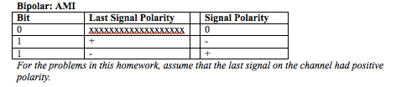
Bipolar - AMI and Pseudoternary
Two pieces of information are needed to determine what signal to put on the line.
Carol Davids © 2014

Slide 100
Multilevel Schemes
Suppose we can create and detect L different signal levels
We might want to assign m data elements (bits) to n signal elements (signal levels)
Carol Davids © 2014

Slide 101
Multilevel Schemes
Taking m bits together, gives 2^{m} distinct data patterns
Taking n signal elements together, gives L^{n} distinct signal patterns
This means there are n signal elements to be considered as a group, and each one could on any of L different levels
Carol Davids © 2014

Slide 102
Multilevel Schemes
The mapping would look like this:
Bit pattern | Level pattern
bbbb | LLL
bbbb | LLL
Carol Davids © 2014

Slide 103
Multilevel Schemes
Suppose L = 4, so that you can create and detect 4 distinct levels.
Suppose you decide to take groups of 3 signal elements at a time.
How many different patterns of 4 levels taken 3 at a time can you make?
Carol Davids © 2014

Slide 104
Multilevel Schemes
Let the level values be A, B, C, and D
The pattern is XXX
You can choose the first X one of 4 different ways.
Once chosen, you can choose the next X one of 4 ways. (so far there are 4x4 patterns)
Now you can choose the last X one of 4 ways. (now there are 4X4X4 patterns)
Carol Davids © 2014

Slide 105
Multilevel Schemes
So there are 4³ different patterns you can get if your signal can take on one of 4 values and you decide to take your signals 3 at a time.
Generalizing this, there are L^{n} different patterns you can get if your signal can take on one of L different values and you decide to take your signals n at a time.
Carol Davids © 2014

Slide 106
Representation of multilevel line codes
mBnL
Where m represents the number of bits in a bit pattern
And n represents the number of signals in a Level pattern
Requires that 2^{m} <= L^{n}
That is to say, you must have at least as many level patterns as there are bit patterns!
Carol Davids © 2014

Slide 107
Examples of multilevel line codes
2B1Q – 2 binary, one quaternary
2 bits represented by one signal, where the signal might take on any one of 4 values
Carol Davids © 2014

Slide 108
Multi-level: 2B1Q code book
Bit Pattern
Last Signal Polarity
Signal Value
2-Bit patterns - rather than individual bits - are represented by one of 4 signal levels
2 pieces of information are needed to decide which of the signal levels to use
00
+
+1
00
-
-1
01
+
+3
01
-
-3
10
+
-1
10
-
+1
11
+
-3
11
-
+3
Carol Davids © 2014

Slide 109
Multi-level: 2B1Q uses
Examples of applications that use 2B1Q line codes are:
DSL
ISDN
Carol Davids © 2014

Slide 110

Multilevel - 8B6T
Encodes 8 bits as a pattern of 6 signal elements where the signal elements can take on any one of three (ternary) levels
Carol Davids © 2014

Slide 111
Multilevel - 8B6T
You can make 2⁸ = 256 different patterns of bits taken 8 at a time. So there are 256 distinct bit patterns you need to map
Carol Davids © 2014

Slide 112
Multilevel - 8B6T
You can make 3⁶ = 729 different patterns of ternary signal levels taken 6 at a time. So there are 729 distinct level patterns available to map your 256 distinct bit patterns to.
Carol Davids © 2014

Slide 113
Multilevel - 8B6T
You will have extra level patterns available.
So you can be smart about how you make your mapping
Carol Davids © 2014

Slide 114
Multilevel - 8B6T
That is, you can choose level patterns that will give you good self synchronization and good bandwidth
You can also choose the patterns in such a way that the sum of the positive and negative polarities in any pattern adds up to zero. This will keep the DC component and DC bias low.
Carol Davids © 2014

Slide 115
Multilevel - 8B6T
r = 4/3 – encodes 8 bits as a pattern of 6 signal elements
Synchronization - ok, done using redundant bits
DC bias - ok, done using redundant bits to flip polarity
Carol Davids © 2014

Slide 116
Multilevel - 8B6T uses
100 BASE-4T Ethernet cable
Specified by ANSI X3T9.5 committee
Used by FDDI and TP-PMD to achieve a data rate of 100MB/s using a 31.25MHz signal.
Carol Davids © 2014

Slide 117
Multi Level Transmission - 3
MLT-3 uses 3 signal levels, +V, -V and 0
MLT-3 uses 3 transition rules to determine which level to put onto the line next
Thus it is not a nBmL type of line code
It is more like the NRZ-I and the Differential Manchester
Carol Davids © 2014

Slide 118
MLT-3 code book
Bit to send
Last Signal
Last non-zero polarity signal
Signal value
0
0
x
0
0
-
x
-
0
+
x
+
1
0
-
+
1
0
+
-
1
-
x
0
1
+
x
0
Carol Davids © 2014

Slide 119

Multi-Level Transmission - MLT-3
Bandwidth - S_{ave} = N/3
r = 1
Carol Davids © 2014

Slide 120
Block Coding
Block coding takes a pattern of m bits and maps it to a pattern to n bits
It is represented as mB/nB
This represents pre-processing NOT line coding.
Why?
Because the result of the block encoding is the creation of a different bit pattern NOT a signal pattern.
Carol Davids © 2014

Slide 121
Block Coding
It is still necessary to apply a line code to the resulting new bit pattern.
Block encoding allows you to send extra – overhead – information along with your data.
Block encoding also allows you to improve your bandwidth and self synchronization by selecting which bit patterns to allow.
Carol Davids © 2014

Slide 122

Block Coding
Illustration 4.14 shows the process of changing an m bit pattern into an n bit pattern.
You still need to apply a line code to get the new pattern onto the link.
Carol Davids © 2014

Slide 123

Block Coding
Illustration 4.15 shows the pre-processing block coding, 4B/5B, followed by the line coding NRZ-I that actually puts signals onto the link.
Carol Davids © 2014

Slide 124
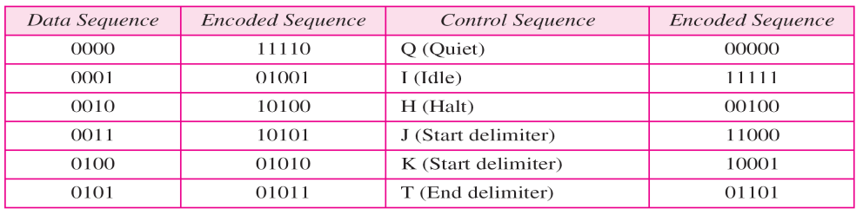

Block Coding
Table 4.2 shows how overhead information can be sent in the link, since there are signal patterns that do not represent actual user data.
Carol Davids © 2014

Slide 125
Scrambling
Scrambling is a method for substituting one bit pattern for a different bit pattern of the same length.
Like Block Encoding it is pre-processing, not really a line code.
After scrambling takes place, it is still necessary to apply a line code to get the new bit pattern onto the link.
Carol Davids © 2014

Slide 126
Scrambling or Substitution
This is a general method used to alter the signal you put onto the line without changing the information content
B8ZS and HDB3 are two examples
They alter the data stream in a pre-defined way in order to prevent signal degeneration
They do this by substituting different data patterns and then line-coding the substituted patterns
Carol Davids © 2014

Slide 127
B8ZS
Binary 8 Zero-bit Substitution uses the scrambling technique.
It is a particular variety of AMI (bipolar) line code that inserts intentional bipolar violations into the signals on the line.
Carol Davids © 2014

Slide 128
B8ZS
Why? Because it is possible to lose synchronization using an AMI code in case there is a long string of ‘0’s in the data.
So B8ZS encoding counts ‘0’s.
If 8 consecutive ‘0’s appear in the data, they are NOT SENT.
Carol Davids © 2014

Slide 129
B8ZS
Instead, a special bit pattern is substituted and encoded into signals on the wire.
When the far end received detects that pattern, it knows that the bits that were in the original data are a string of 8 ‘0’s.
So the receiver does not send up the phony bit pattern, it sends up 00000000 instead.
Carol Davids © 2014

Slide 130
B8ZS
The phony bit pattern that gets encoded and put onto the wire is :
0 0 0 V 1 0 V 1
Where V is a bipolar violations
Carol Davids © 2014

Slide 131
B8ZS
This means that if the last ‘1’ sent was encoded with a + signal value, then 00000000 will be encoded:
0 0 0 V 1 0 V 1
0 0 0 + - 0 - +
And, if the last ‘1’ sent was encoded as -, then 00000000 will be encoded:
0 0 0 - + 0 + -
Carol Davids © 2014

Slide 132
Unipolar - code book
Bit 0 is represented by a pulse with polarity 0
Bit 1 is represented by a pulse with polarity +
Bit
Signal Polarity
0
0
1
+
Carol Davids © 2014

Slide 133
Polar: NRZ-L code book
Bit 0 is represented by a pulse whose polarity is +
Bit 1 is represented by a pulse whose polarity is -
Bit
Signal Polarity
0
+
1
-
Carol Davids © 2014

Slide 134
Polar: NRZ-I code book
Bit 0 is represented by no transition of polarity at the left edge of the pulse
Bit 1 is represented by a transition of polarity at the left edge of the pulse
Bit
Signal Transition at left edge
0
N
1
Y
Carol Davids © 2014

Slide 135
Polar: RZ - code book
Bit 0: signal polarity is negative at the left edge and goes to zero in the middle
Bit 1: signal polarity is positive at the left edge and goes to zero in the middle
Bit
Signal polarity at left edge
0
N
1
P
Carol Davids © 2014

Slide 136
Manchester code book
Bit 0: The direction of the polarity transition in the middle of the bit interval is down
Bit 1: The direction of the polarity transition in the middle of the bit interval is up.
Bit
Center transition direction
0
D
1
U
Carol Davids © 2014

Slide 137
Differential Manchester code book
Bit 0: The signal’s polarity transitions at the left edge of the pulse
Bit 1: The signal’s polarity does not transition at the left edge of the pulse.
Bit
Signal Transitions at left edge
0
Y
1
N
Carol Davids © 2014

Slide 138
Bipolar AMI and Pseudoternary code book
Bit 0: polarity zero
Bit 1: polarity depends on polarity of previous bit 1
Bit
Last Signal Polarity
Signal Polarity
0
xxxxxxxxxxxxxxxxxxx
0
1
+
-
1
-
+
Carol Davids © 2014

Slide 139
MLT-3 code book
Bit to send
Last Signal
Last non-zero polarity signal
Signal value
0
0
x
0
0
-
x
-
0
+
x
+
1
0
-
+
1
0
+
-
1
-
x
0
1
+
x
0
Carol Davids © 2014

Slide 140
Transmission Mode
Transmission of binary data across a link can be done in one of two modes:
  Parallel
  Serial
Carol Davids © 2014

Slide 141
Parallel Transmission
Uses one conductor for each bit and sends all 8 bits out on the same clock tick.
This means all 8 bits arrive at the destination at the same time.
This makes it fast.
This also consumes a lot of conductors - so it is costly.
Carol Davids © 2014

Slide 142
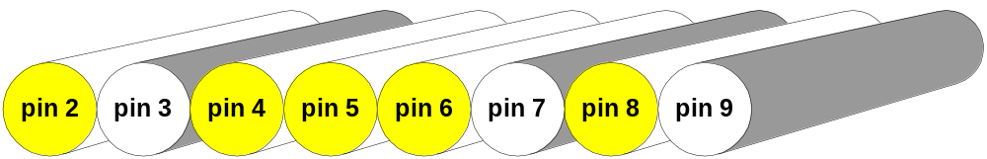
Parallel Transmission
KEY:
Yellow - encodes 1
White - encodes 0
All the voltage levels arrive simultaneously on different conductors.
Carol Davids © 2014

Slide 143
Parallel transmission
  Printers, scanners and other peripherals attached directly to a PC often use parallel communications.
  These are very fast, but cannot be transmitted over great distances.
  The standard parallel port is capable of sending 50 to 100 kilobytes of data per second.
  Parallel ports were originally developed by IBM as a way to connect a printer to your PC.
Carol Davids © 2014

Slide 144
Serial Transmission
  In serial transmission, only one conductor is used.
  One bit is sent on each clock tick.
  This makes serial transmission slower than parallel.
  But serial transmission costs less than parallel since only one conductor is needed.
Carol Davids © 2014

Slide 145
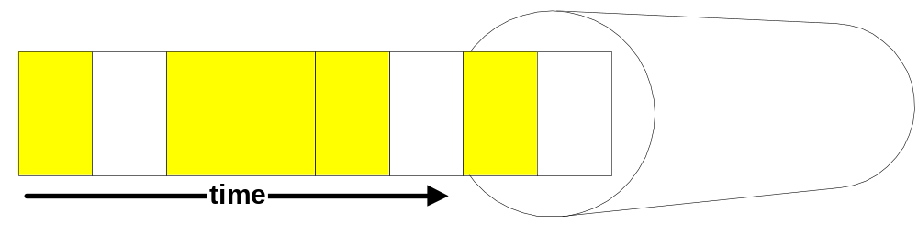
Serial Transmission
The voltage levels arrive over a period of time on the same conductor.
Carol Davids © 2014

Slide 146
Serial Transmission
  There are two types of serial transmission:
  Asynchronous
  Synchronous
Carol Davids © 2014

Slide 147
Asynchronous Serial Transmission
  Information is received and translated using patterns.
  Patterns are based on grouping bits into groups of 8 called bytes.
  The sending system handles bytes as a unit.
  It alerts the receiver that is about to receive a byte by sending a start bit - usually a ‘0’.
Carol Davids © 2014

Slide 148
Asynchronous Serial Transmission
  To inform the receiver that the byte has been sent, the sender will send a stop bit -usually a 1.
  The addition of the start bit and the stop bit, and possibly also a gap or period during which no bits are sent, causes asynchronous data transmission to be relatively slow.
Carol Davids © 2014

Slide 149
Asynchronous Serial Transmission
  When the receiver gets a start bit, it needs to start up its clock.
  The bytes are sent asynchronously.
  Within the byte it is necessary to use a clock to correctly interpret the voltage pattern being received.
Carol Davids © 2014

Slide 150
Asynchronous Serial Transmission
  The connection of a keyboard to a computer is well suited for asynchronous serial transmission.
  The data sent is naturally divided into 8 bit bytes representing letters and numbers.
  The data is sent very slowly since it is human input.
Carol Davids © 2014

Slide 151
Synchronous Serial Transmission
  Synchronous transmission contains multiple bytes combined into longer frames.
  There are no start and stop bits and no gaps that provide information as to where one byte ends and another begins.
  The receiver must distinguish between the bytes and bits without this overhead.
Carol Davids © 2014

Slide 152
Synchronous Serial Transmission
  If there a periods during which the sender has no data to put onto the line, the sender must still send data during these periods.
  The data is a special idle pattern.
  The receiver counts bits and groups them into 8-bit bytes.
  This means that the clock in the receiver needs to be synchronized with the clock in the sender.
Carol Davids © 2014

Slide 153
Synchronous Serial Transmission
  Synchronous data is faster than asynchronous since it does not rely on extra overhead bits and gaps.
  It is used for transmission of data from one computer to another.
  The bytes need to be synchronized.
  Byte synchronization is provided by the data link layer.
Carol Davids © 2014

Slide 154
Connectors
  A few physical connectors are pictured and described briefly on the next pages.
  Layer 1 issues associated with connecting data equipment to a data network include:
    the number of conductors on the cable
    the number of pins on the connector
    the use of each pin in the establishment of a physical connection.
Carol Davids © 2014

Slide 155
Connectors: RJ-45
  RJ-45 (Registered Jack - Type 45) is a physical interface often used for terminating twisted pair type cables.
  "RJ" stands for Registered Jack.
  It has eight “ pins" per connector.
  Standards such as TIA-568B define which wires to connect to which pin.
  Reference: http://en.wikipedia.org/wiki/RJ45
Carol Davids © 2014

Slide 156
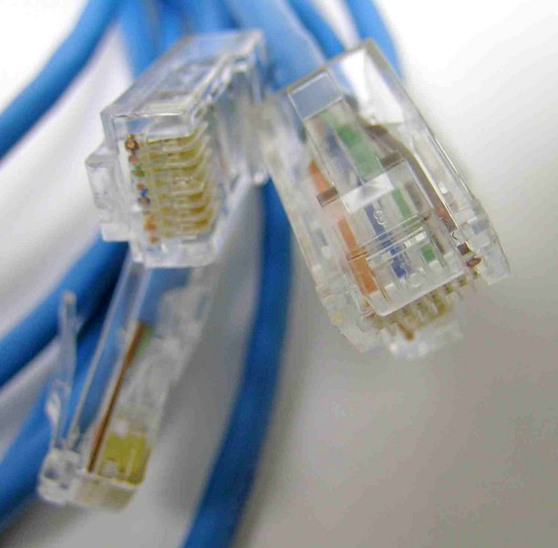
Connectors: RJ-45
Carol Davids © 2014

Slide 157
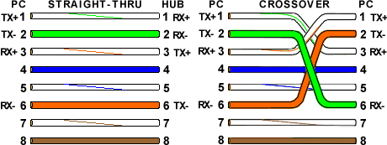
RJ-45: T-568A Straight-Through and Crossover Ethernet Cables – Use of the pins
This diagram tells you how each conductor is used.
Carol Davids © 2014

Slide 158
RJ-45: T-568A Straight-Through and Crossover Ethernet Cables – Use of the pins
This diagram tells you how each conductor is used.
Carol Davids © 2014

Slide 159
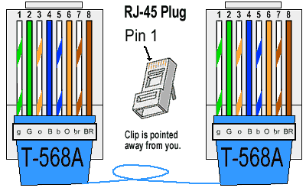
RJ-45: T-568A Straight-Through Ethernet Cable
  Pin-out associated with the T-568A standard.
Carol Davids © 2014

Slide 160
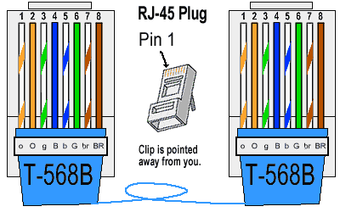
RJ-45: T-568B Straight-Through Ethernet Cable
  Pin-out associated with the T-568B standard.
Carol Davids © 2014

Slide 161
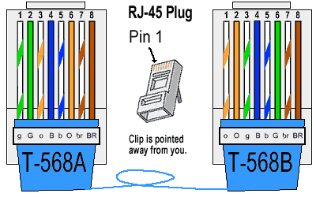
RJ-45: Crossover Cable
  Pin-out for a crossover cable – used to connect two ethernet devices without using a hub or switch.
Carol Davids © 2014

Slide 162
Connectors: V.35
  V.35 is an ITU standard for high-speed synchronous data exchange.
  Use V.35 to connect a Router to a T-1 carrier.
  Use V.35 to connect a Data Service Unit (DSU) to a T-1 carrier.
  http://www.webopedia.com/TERM/V/V_35.html
Carol Davids © 2014

Slide 163
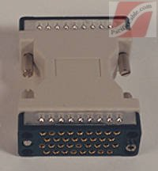
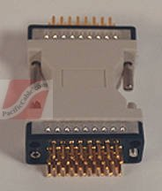
Connectors: V.35
http://www.pacificcable.com/
Carol Davids © 2014

Slide 164
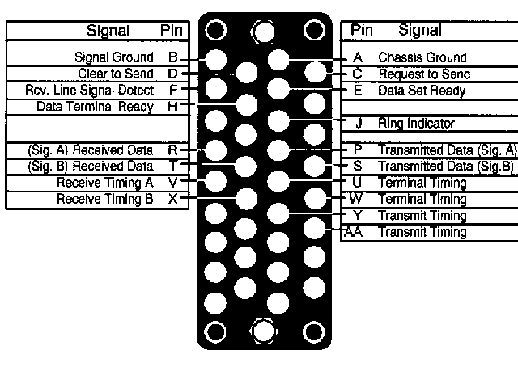
Connectors: V.35
http://www.arcelect.com/v35.htm
Carol Davids © 2014

Slide 165
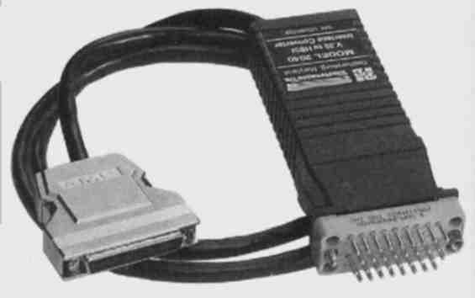
Converting V.35 to other formats
http://www.arcelect.com/V35_to_HSSI_CONVERTER-10MBPS.htm
Carol Davids © 2014

Slide 166
Connectors: RS-232
  Used as an electrical interface between Data Terminal Equipment (DTE) and Data Circuit-Terminating Equipment (DCE) such as modems or DSUs.
  RS-232 is used for both asynchronous data transfer and for synchronous links such as SDLC, HDLC, Frame Relay and X.25.
  http://www.camiresearch.com/Data_Com_Basics/RS232_standard.html
Carol Davids © 2014

Slide 167
Connectors: RS-232
  There is a standardized configuration of the pins for RS-232 on a DB25 connector, shown on the next page.
  On RS-232 the signals are carried as single voltages referred to a common ground on pin 7.
Carol Davids © 2014

Slide 168
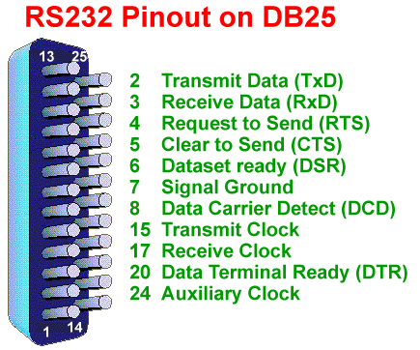
Carol Davids © 2014

Slide 169

http://www.winfordeng.com/products/con25.php
Carol Davids © 2014

Slide 170
Connectors: USB
  The USB standard uses a different logic - instantiated in hardware and software
Carol Davids © 2014

Slide 171
The End
Carol Davids © 2014

